Slide 1
Lesson Overview
Day 1
Stop and Think- students complete stop and think 5 mins
Video and discussion- video shows anchoring phenomena- fish dying in a local pond- discuss what the video showed 5-7 mins
Models and criteria review- remind students what is a scientific model, and of the criteria they generated on the class criteria list yesterday 3 mins
Create initial models- students will make an initial model with their group 30 mins
Before you go- brief review of groups’ models 5 mins
Total time: 50 mins

Slide 2
STOP & THINK!
Grab a handout and put your name and information on the top of the first page.
Complete the STOP & THINK! question on the first page.
In our science unit we will try to solve a mystery involving fish in a pond.
What do you think fish in a pond need in order to be healthy and survive?
Notes:
Use this “Stop & Think” as a do now.
Tell students that the next inquiry unit is science and they will be working like scientists to solve a mystery involving fish in a pond. Have them fill out their details (name, class and date) then answer the Stop & Think question on their handout
Do not hold a class discussion at this point. Just let them do the STOP & THINK, maybe solicit a few answers by asking a couple of students to share but keep this brief and quickly and move on.

Slide 3
Passion Puddle Mystery
The full video would be here. Please contact the STEP team for a copy.
Notes:
Video introduces anchoring phenomena- that fish are dying in a local pond. A few local residents and an official from Parks and Recreation report on what they are seeing in the pond- that the fish are dying.
It is not clear why the fish are dying, so we want students to recognize that question, which becomes the driving question of the lesson (and subsequent): why are fish dying?

Slide 4
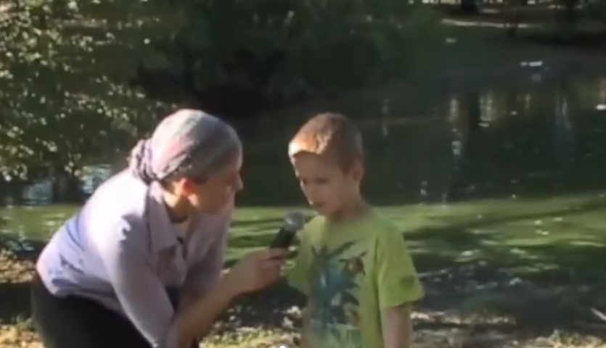
Passion Puddle Mystery
What is happening at Passion Puddle?
Notes:
Discussion prompts:
Ask students if they have ever seen a green pond like the one in the video.
What do they think is making it green?
What is the green stuff?
What might be causing the fish death? (Keep responses to this question brief: the next task for students is to make models showing why they think the fish are dying)

Slide 5

Scientific Models and Criteria
A model is a simple way to show an idea about what or how something is happening
Criteria for good models:
[Photo of class criteria list will be added to this slide]
Notes:
Briefly remind students of what a model is and go over the criteria they came up with.
Questions- might be a good time to ask students if they are unclear about what a model is before diving into making a model.

Slide 6





Why Are The Fish Dying?
Work with your group to make a box-and-arrow model to show you think the fish are dying.
Remember criteria for good models.
why
Dead Fish
Notes:
Students make an initial model to show why they think the fish are dying. Remind students that they can look at the criteria which are publicly posted in the classroom.
At this point, all models that students make are acceptable. There isn’t a “right” answer. Likely models include the following ideas:
1. there isn’t enough of something that fish need (like food/air)
2. pollution in the water is killing the fish
3. Rise in temperature is killing the fish
→ As you walk around, keep an eye out for which group has which idea, and if there are any other ideas.
In the next step we will winnow them down to a few categories.
Walk around and make sure students are attending to the criteria list as they make the models. Remind them to attend to the criteria.

Slide 7




Your Model
Dead Fish
On your own handout, explain your group’s model in your own words.
We will be sharing our models later, so think about how you can explain your model to other people.
Notes:
•Goal- to cluster the models by similar type. For example, all groups who stated lack of food as a reason for fish dying.
•To do this, ask one group to share their model. After that, ask if any other group had a similar model. If they do, they can place their model next to the first (the model clusters should be on the wall in groupings)
•After this, ask if anybody had a very different idea, and ask one of those groups to share.
•Repeat – ultimately, there are likely to be 3-4 clusters of models, likely including:
there isn’t enough of something (like food/air)
pollution in the water
Temperature
Other: there isn’t a “right” answer so accept all student models
•As students present, ask the class to pay attention to whether:
They gave reasons- do they give reasons for why the fish are dying?
Did they use criteria for good models?
How is their model the same or different to models in the class/their own model?
•Keep these questions in mind to ask after students share their models throughout the unit
•This discussion may raise opportunities to revise the model criteria list - keep an eye out for such opportunities

Slide 8

Our Models
Let’s look at some of the models now.
As groups share, think:
What reason did they give for why the fish are dying?
Is my group’s idea similar or different?
Notes:
•Goal- to cluster the models by similar type. For example, all groups who stated lack of food as a reason for fish dying.
•To do this, ask one group to share their model. After that, ask if any other group had a similar model. If they do they can place their model next to the first (the model clusters should be on the wall in groupings)
•After this, ask if anybody had a very different idea, and ask one of those groups to share.
•Repeat – ultimately, there are likely to be 3-4 clusters of models, likely including:
- there isn’t enough of something (like food/air)
- pollution in the water
- Temperature
Other: there isn’t a “right” answer so accept all student models
•As students present, ask the class to pay attention to whether:
They gave reasons- do they give reasons for why the fish are dying?
Did they use criteria for good models?
How is their model the same or different to models in the class/their own model?
•Keep these questions in mind to ask after students share their models throughout the unit
•This discussion may raise opportunities to revise the model criteria list - keep an eye out for such opportunities

Slide 9
BEFORE YOU GO
Grab a note and put your name on it.
Complete the BEFORE YOU GO questions.
Look at our different models. Which model do you think is best? Why?
Write your answer and reason on your sticky note.
Stick the note on that group of models.
Notes:
END OF DAY 1
Use this “Before You Go” as an exit ticket.
Have the students write a reason for why they think a particular cluster is best and then have them stick it on that cluster
Tell students they will be figuring out which idea is best in future classes.
Do not hold a class discussion at this point,

